Slide 1

Battery Parameter
of
Different SOC

Slide 2
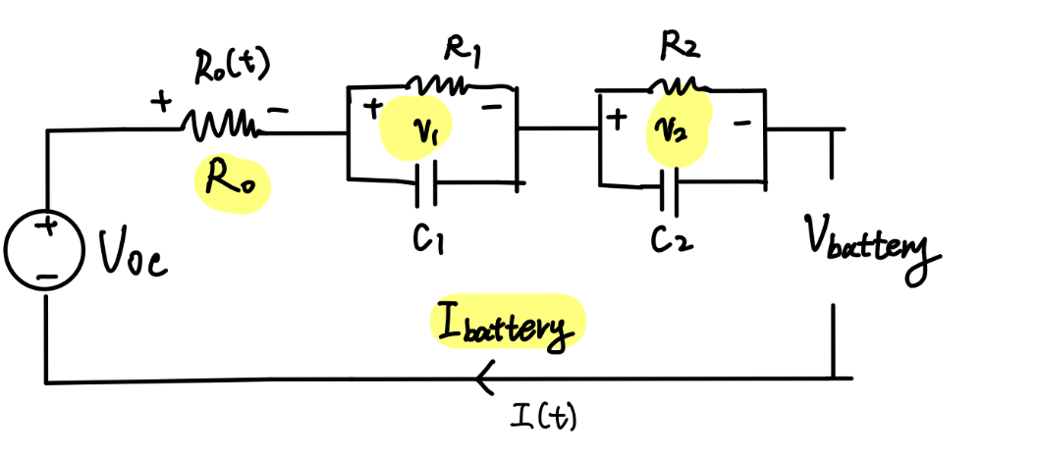
Equivalent Circuit Model
R-2RC Model
R0 stands for resistance of contacts, electrodes, and electrolytes.
RCs simulate the dynamic features during charge and discharge.
$$V\left(t\right){=V}_{oc}−I\left(t\right)R_{0}−I\left(t\right)R_{1}\left({1−e}^{−\frac{t}{C_{1}R_{1}}}\right)−I\left(t\right)R_{2}\left({1−e}^{−\frac{t}{C_{2}R_{2}}}\right)$$

Slide 3
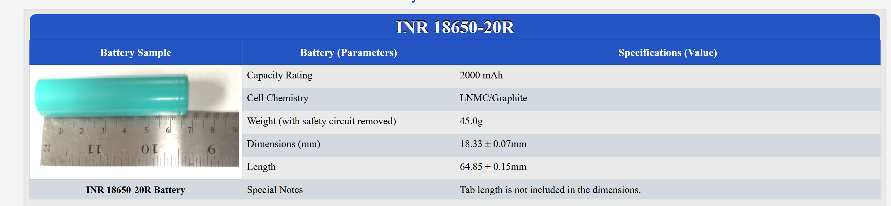
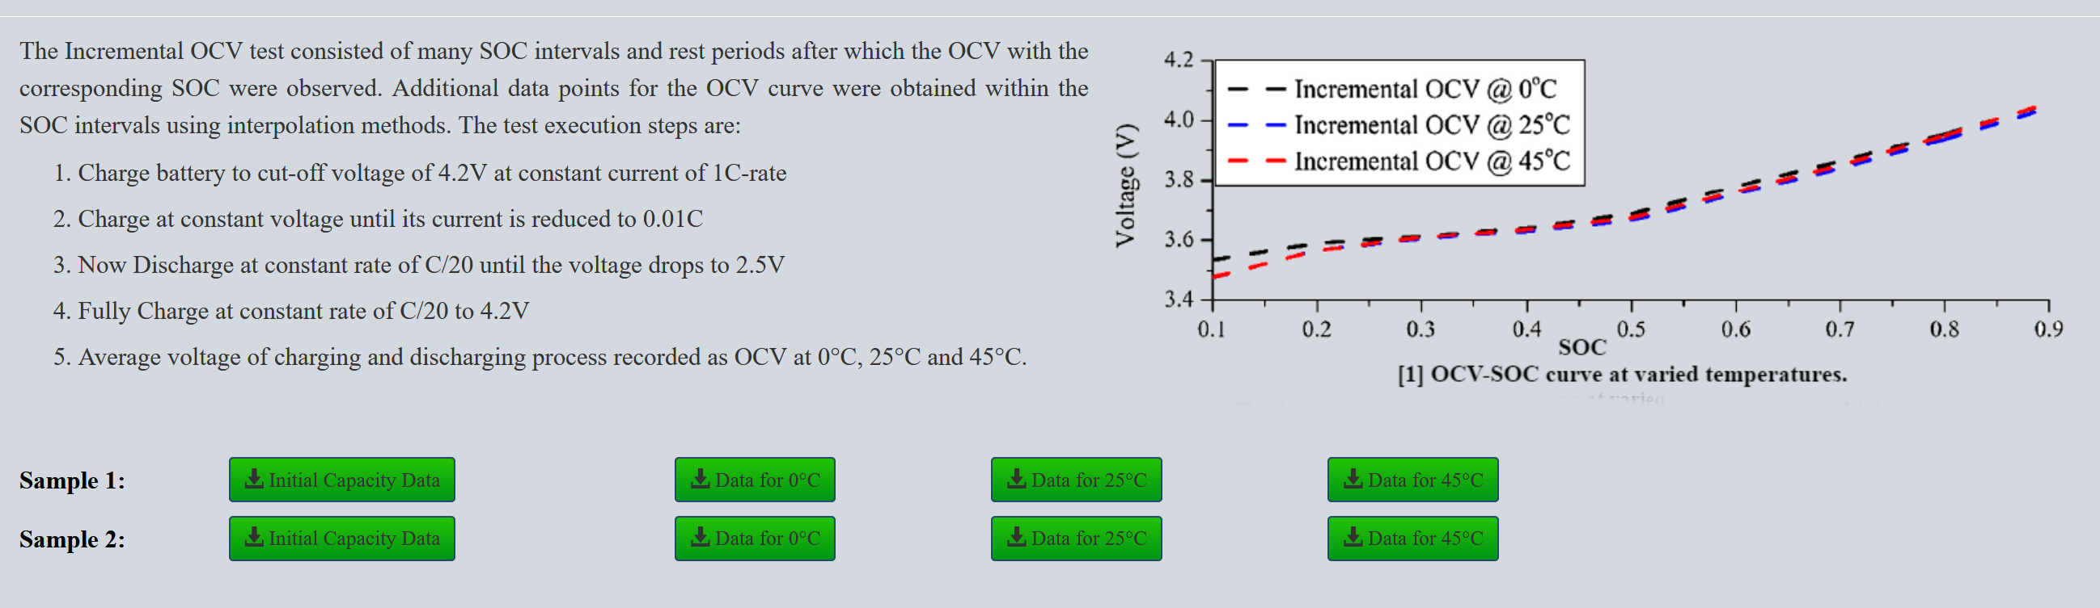
Dataset
[1] Zheng, F. , et al. "Influence of different open circuit voltage tests on state of charge online estimation for lithium-ion batteries." Applied Energy 183.dec.1(2016):513-525.

Slide 4
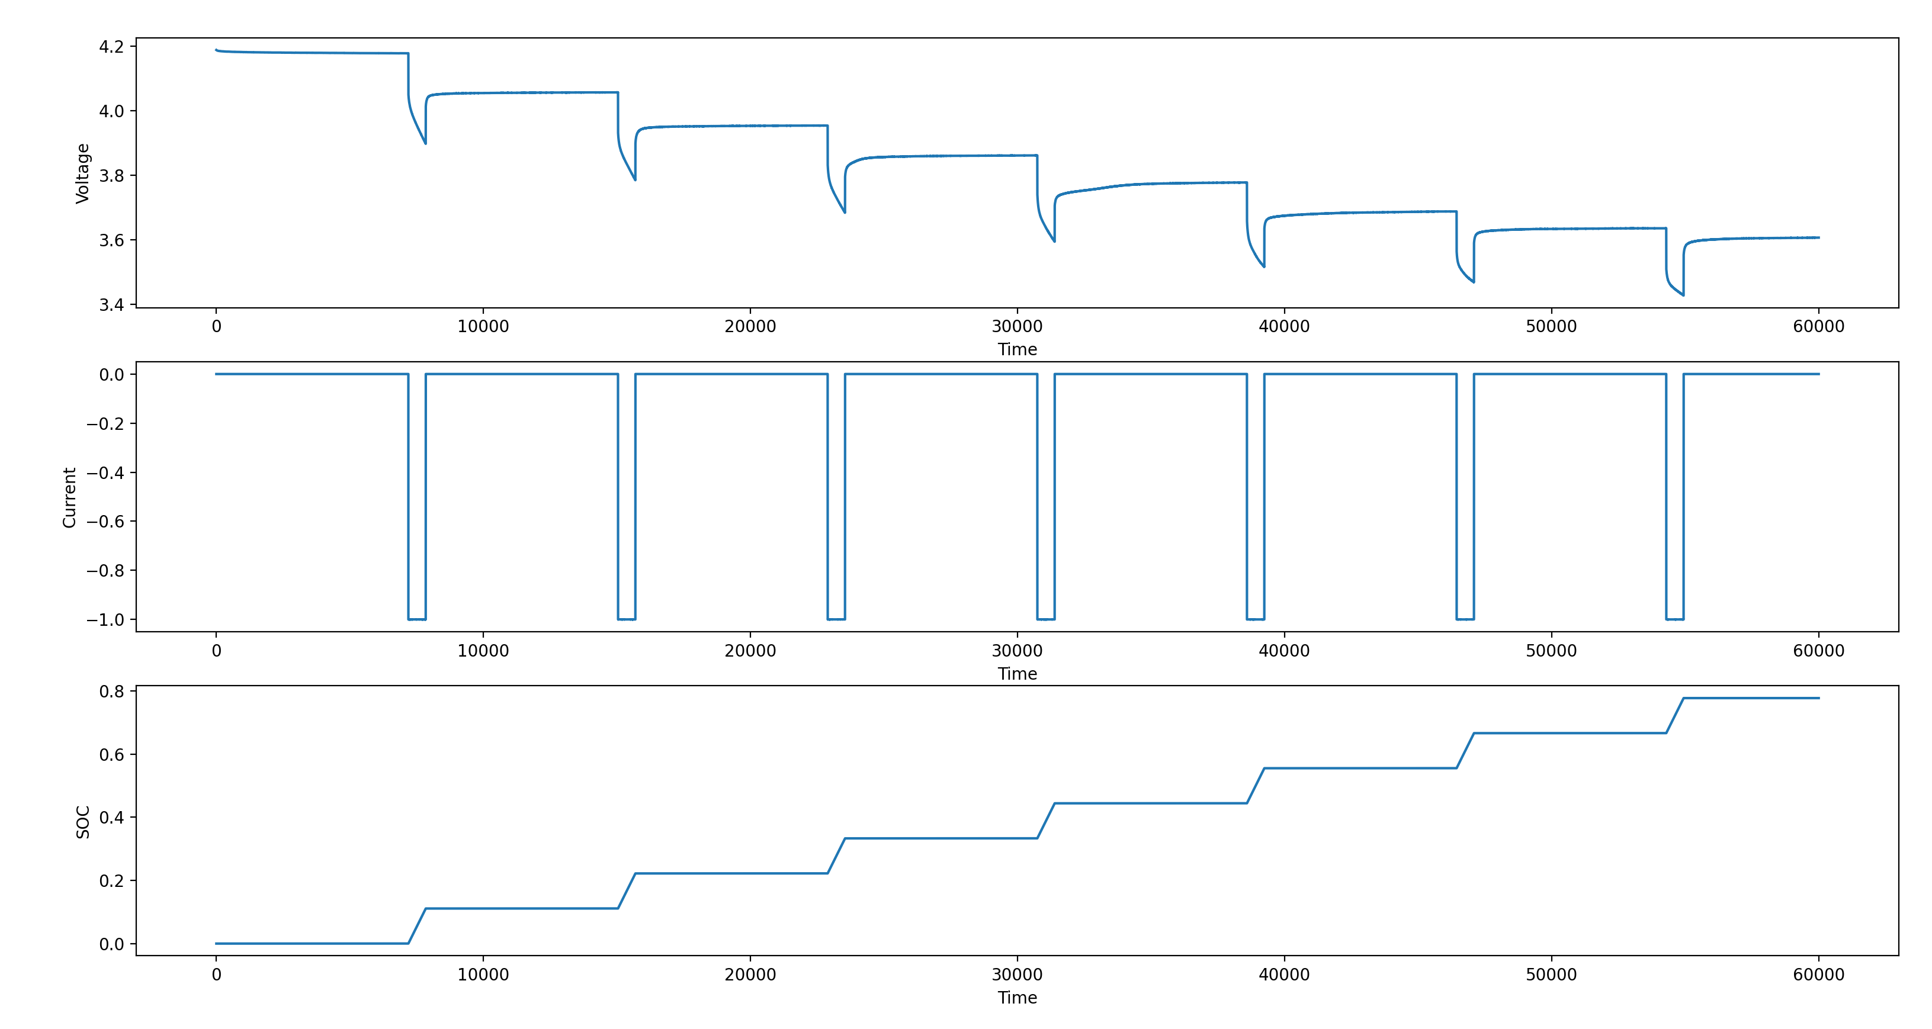
Data Processing – One discharging procedure

Slide 5
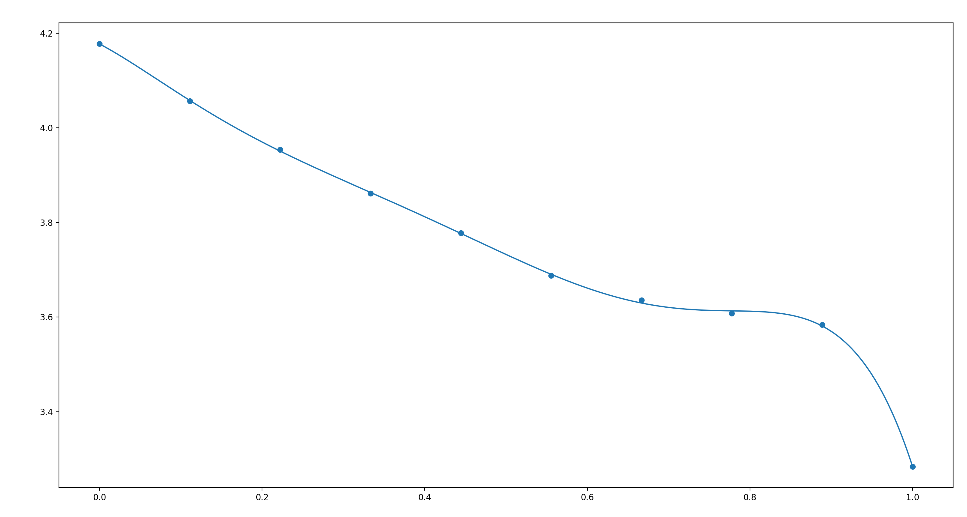
Derive OCV-SOC curve
Voltage
SOC

Slide 6
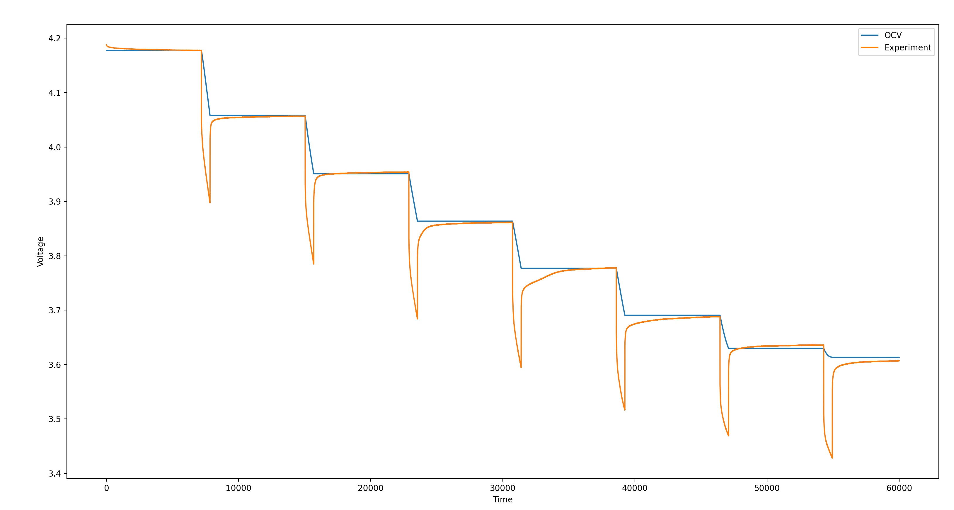
Applying OCV-SOC curve

Slide 7
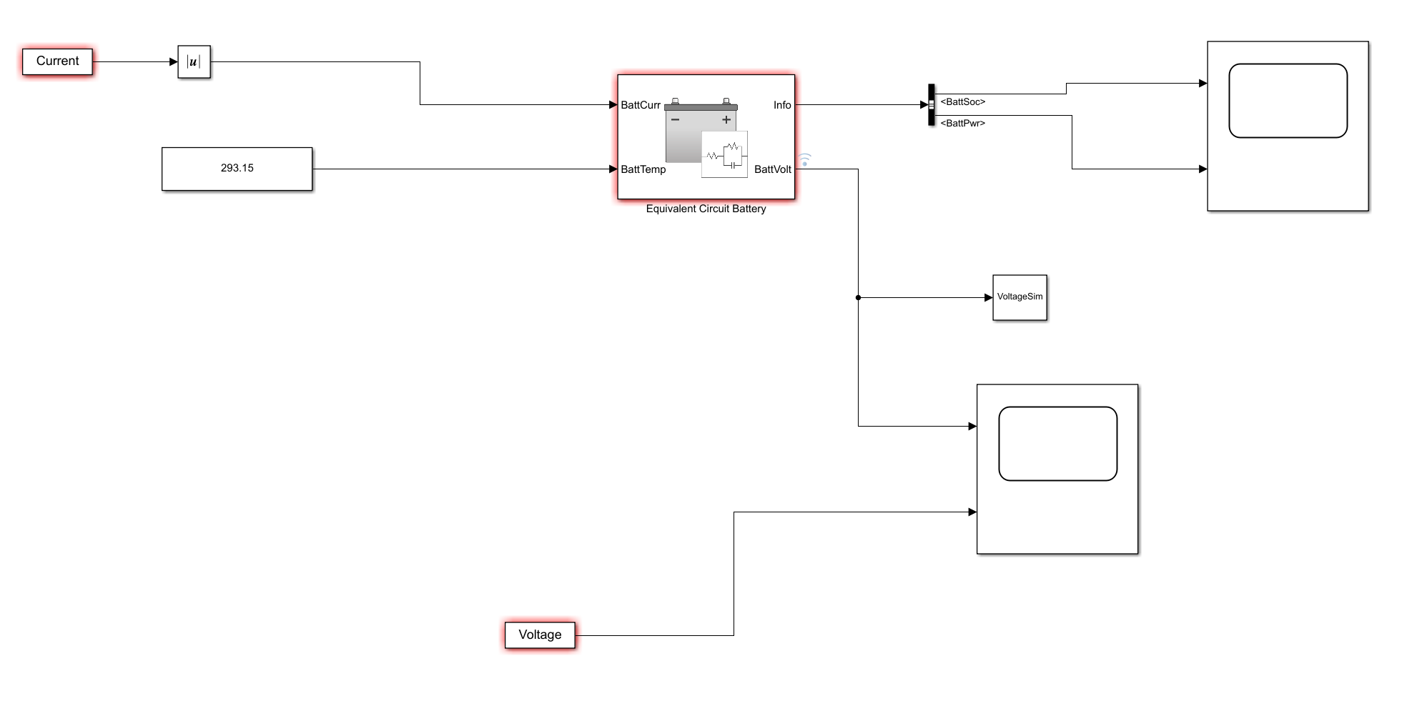
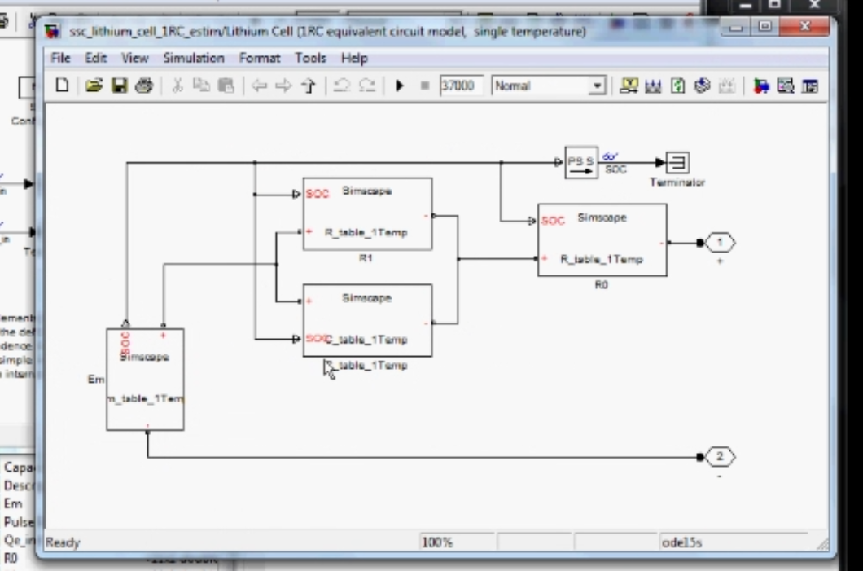
Fitting the Data
https://www.mathworks.com/videos/estimating-parameters-of-a-battery-68957.html

Slide 8
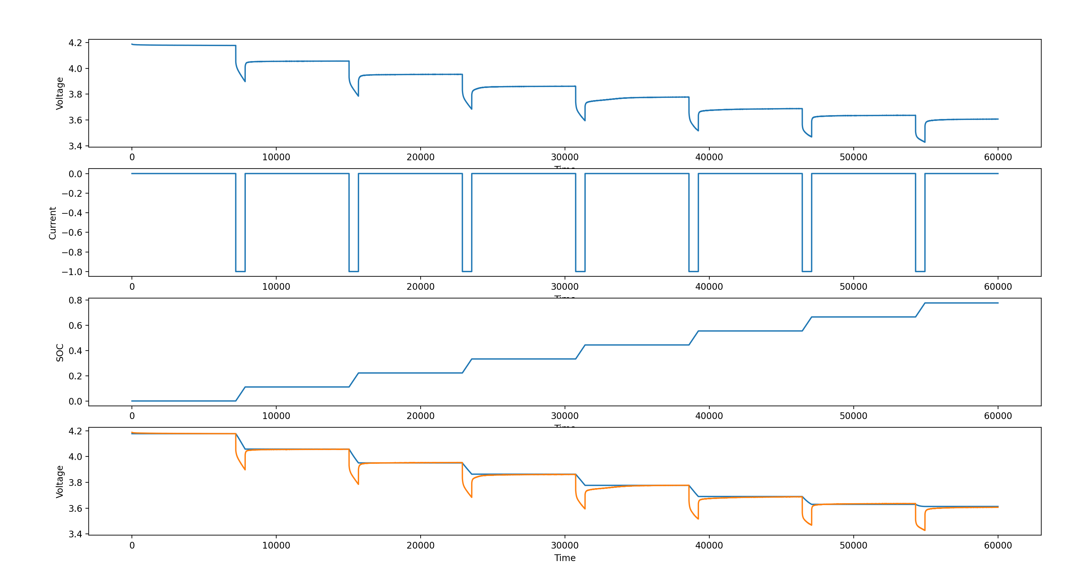
Lookup Table => Split Data to Pulses

Slide 9
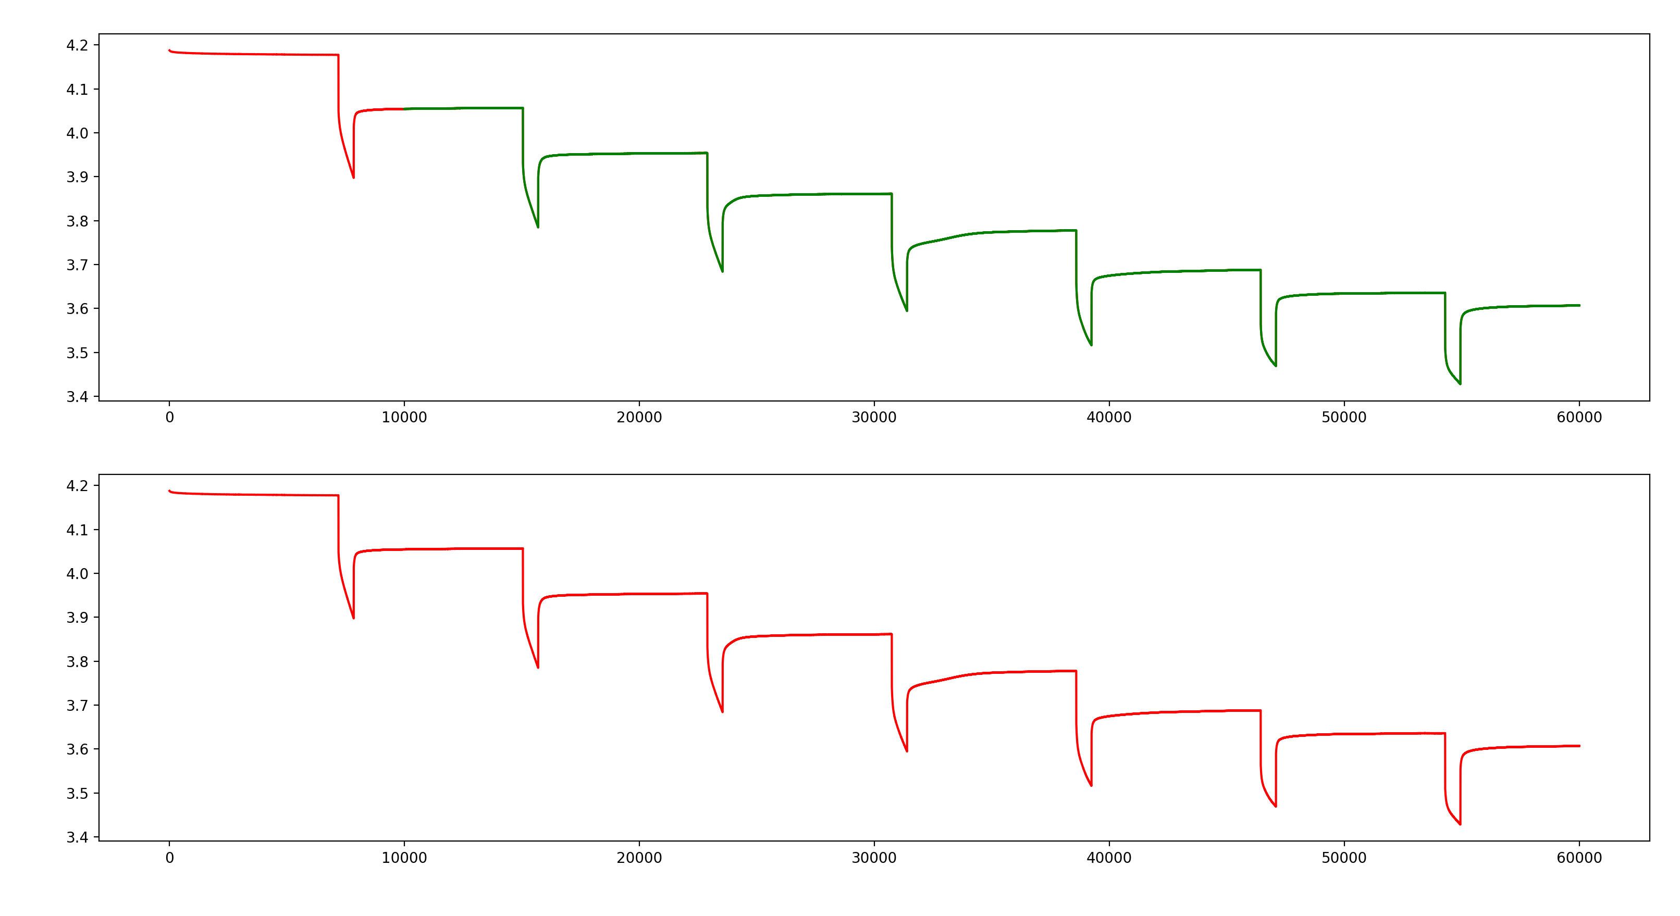
Results
Fit
Exp

Slide 10
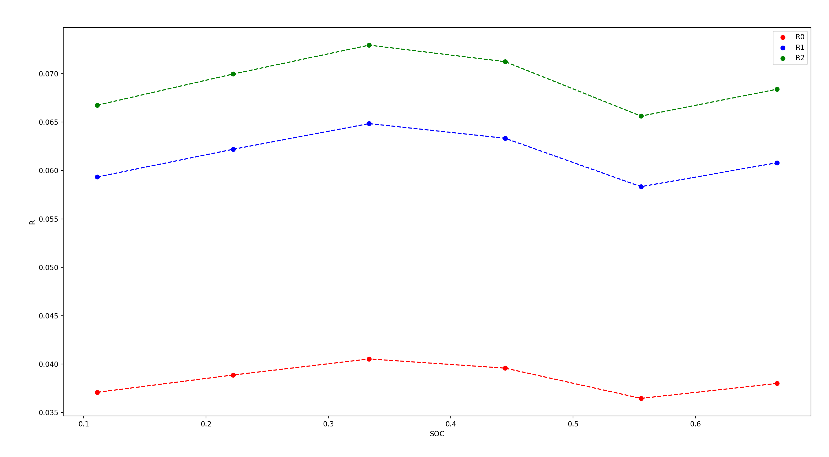
Results

Slide 11

Thank you!

